Slide 1


EWB,INDIA - VVIT
Vasireddy Venkatadri Institute Of Technology
Guntur , Andhra Pradesh
Together we build a Better world.

Slide 2

IUCEE Student Leadership Course
Conducted by Prof. Krishna Vedula, Executive Director,IUCEE
June -October,2019

Slide 3
“Engineering is for Doing not just for Studying”
—Krishna Vedula

Slide 4
Mission:
Collaborate with non-profit organizations and social organisations, understand the potential problems faced by the community, improve the quality of life for common people.

Slide 5
Visión:
To guide and motivate students and professionals to solve real time problems faced by the community with a technology based solution.

Slide 6
TABLE OF CONTENTS
01
02
03
04
WORK BEHIND THE FORMATION OF CHAPTER:
Approached the Faculty and H.O.D’s and informed about the EWB chapter formation.
Informed to our Principal Sir about the chapter formation and Students to join this.
They convinced and we got all the required permissions
Here you could describe the topic of the section
Posted the Interested Students registration link in college website and done classroom promotions encouraging students to join this.
Here you could describe the topic of the section

Slide 7
REGISTRATIONS
111

Slide 8
TABLE OF CONTENTS
01
02
03
04
Activities :
To collaborate and work along with the Non-Profit Organizations.
To conduct workshops like Design Thinking,Conflict Resolution etc.
Discussions on the other EWB chapter activities and enhancing quality of our activities.
Here you could describe the topic of the section
Regular meetings and panel discussions and Inviting Industry experts to give feedback.
Here you could describe the topic of the section

Slide 9
INAUGURATION
6th December,2019
Dr. Shaukat Ali Mirza,
Director at EWB-INDIA

Slide 10
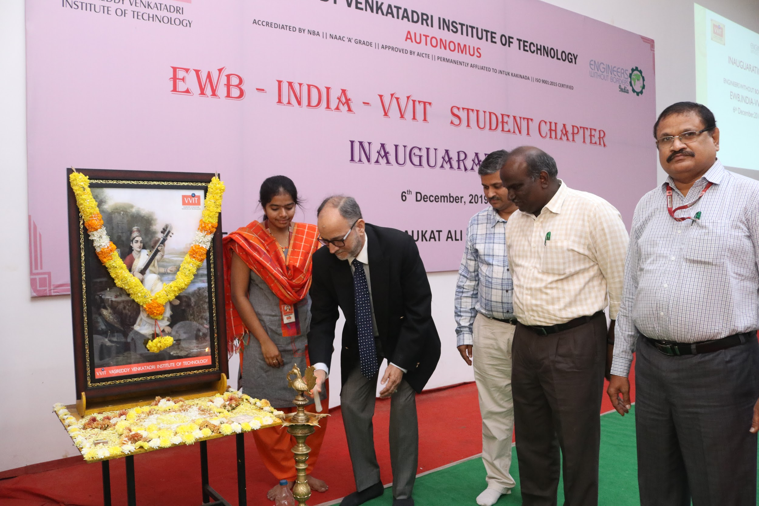
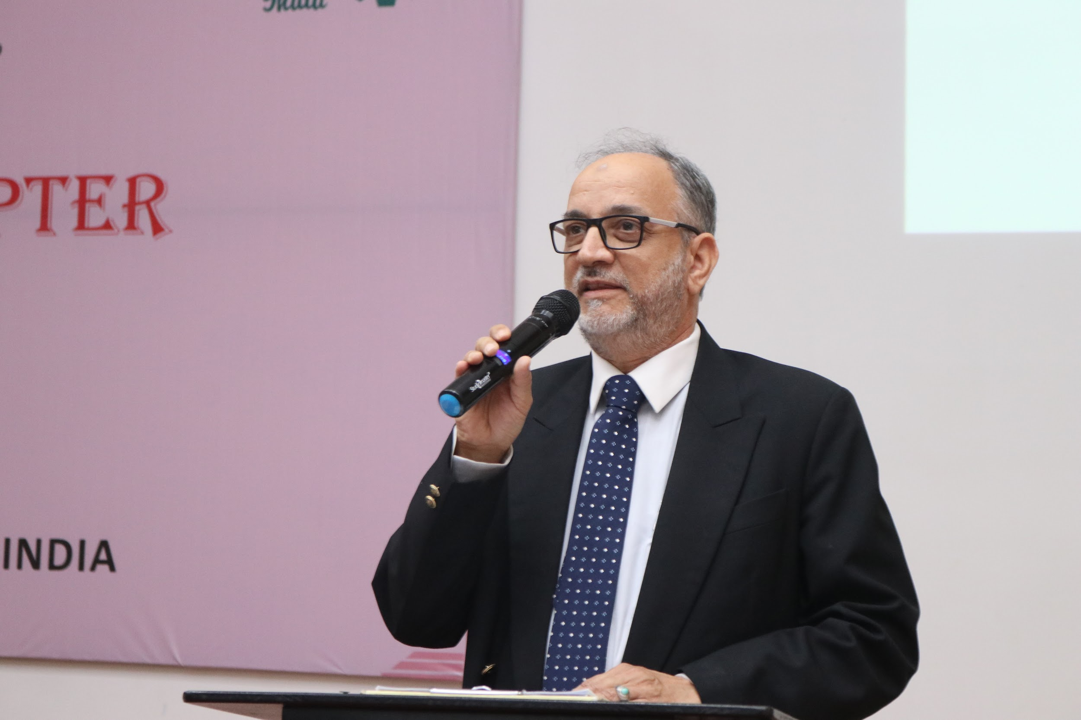
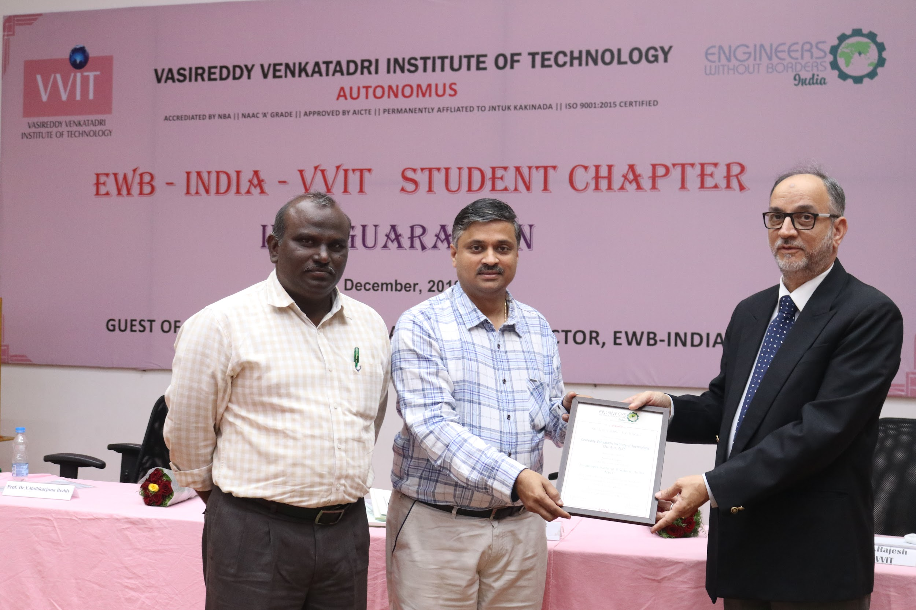

Slide 11
CONFLICT RESOLUTION
WORKSHOP
18th December,2019
To help students to think in the way how the EWB functioning is going to be.

Slide 12
Search
Think
Act
SESSION 1
SESSION 2
SESSION 3
To identify the potential problem of given community.
To identify the solution using brainstorming,design thinking etc.
To create an Action Plan to solve the problem .

Slide 13
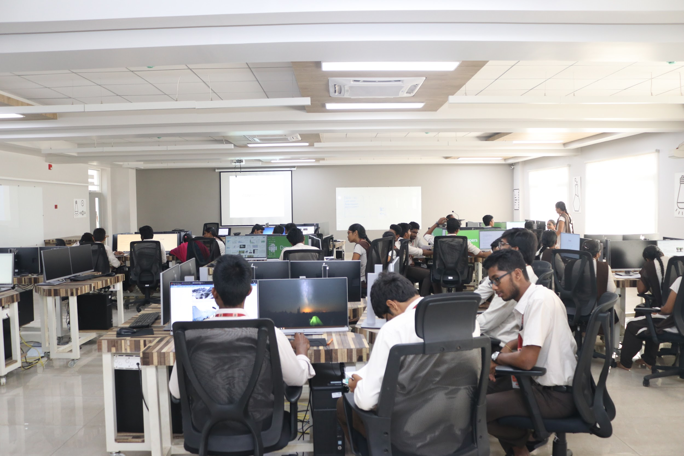
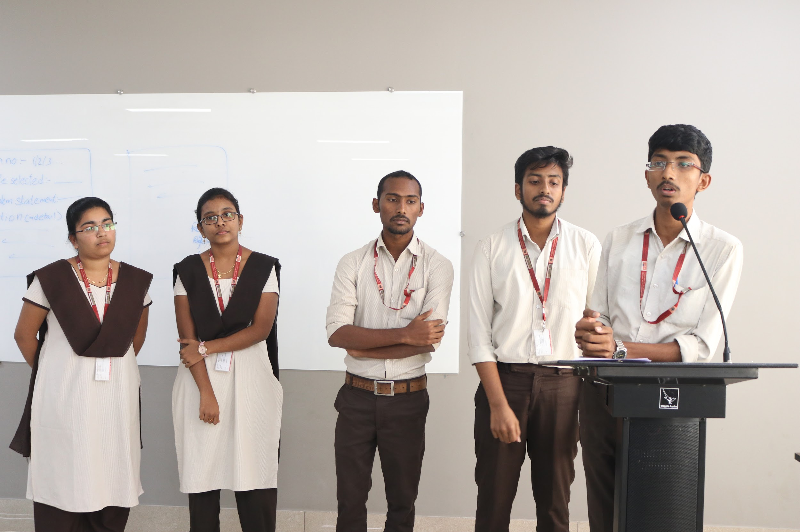
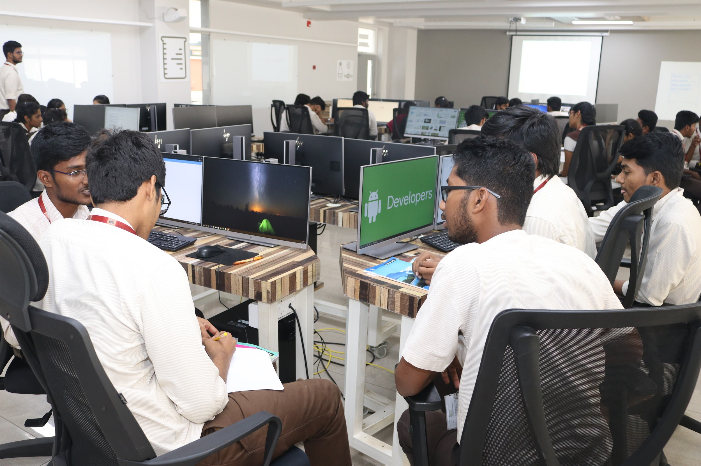

Slide 14
Plans for 2020
Green Engineering Campaign.
Taking Up a real time project in nearby Village.

Slide 15
Green Engineering:
To promote and bring awareness in students about the eco-friendly practices in their domain.
Domain Specific:
Green Computing
Green Mechanics
Green Electronics etc.
General:
Litter free campus
Food wastage
Electricity Saving etc.

Slide 16
Taking up a real time project :
Visiting the villages adopted by the college to identify the problems.
Survey:
Conducting a survey to identify the major problems of village
Solution:
Identify appropriate solution and its feasibility.
Start Doing...

